Slide 1
ASP.NET Core API

Slide 2
AGENDA
The Big Picture
Approaches
The pipeline and middleware

Slide 3
ASP.NET Core
A cross-platform, high-performance, open-source framework for building
modern, cloud-enabled, internet-connected apps

Slide 4
ASP.NET Core: The Big Picture
Build web apps and services, IoT apps and mobile backends
Develop on Windows, Linux and macOS
Deploy to the cloud or on-premises
Run on .NET (or .NET Core, depending on the version)

Slide 5
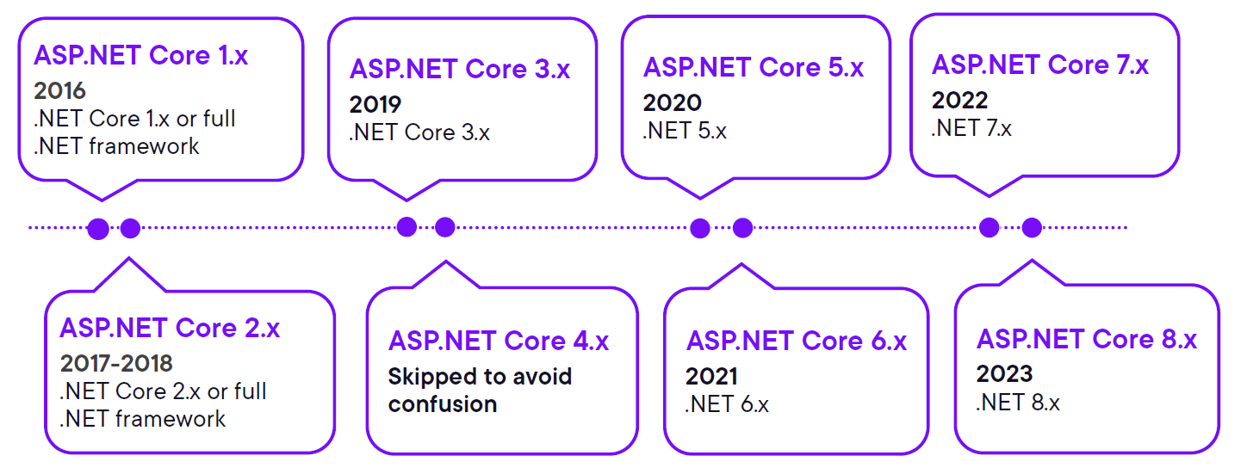
ASP.NET Core History

Slide 6


ASP.NET Core History
Full .NET framework (4.8)
No new development
.NET Core vNext (“4.x”)
Useful functionality from the full .NET
framework ported to increase performance
and support cross-platform development

Slide 7


Approaches to Building APIs with ASP.NET Core
ASP.NET Core Minimal API
ASP.NET Core MVC

Slide 8
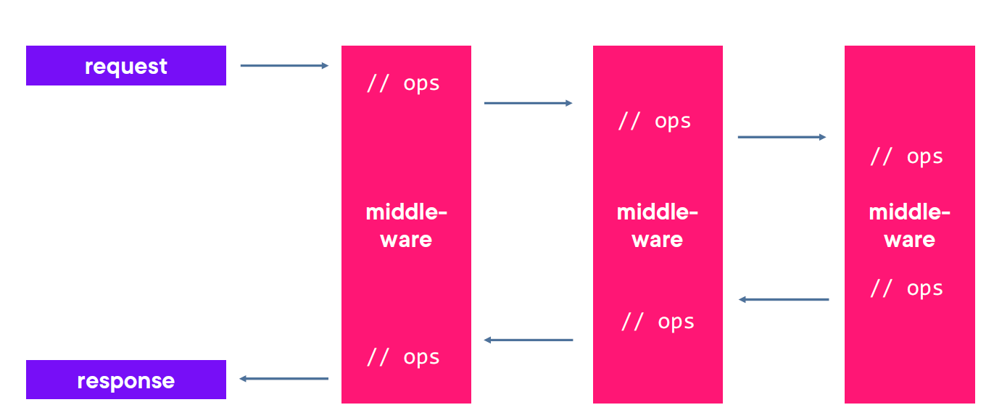
The ASP.NET Core Request Pipeline & Middleware
Middleware
Software components that are assembles into an application pipeline to
handle requests and responses

Slide 9
AGENDA
Clarifying the MVC pattern
Status codes
Problem details
Content negotiation

Slide 10
Clarifying the MVC Pattern
Very common pattern
- Exists in many languages, supported by
many frameworks
- Used to build client-facing ASP.NET Core
web applications
Improves separation of concerns
Improves testability
Promotes reuse

Slide 11
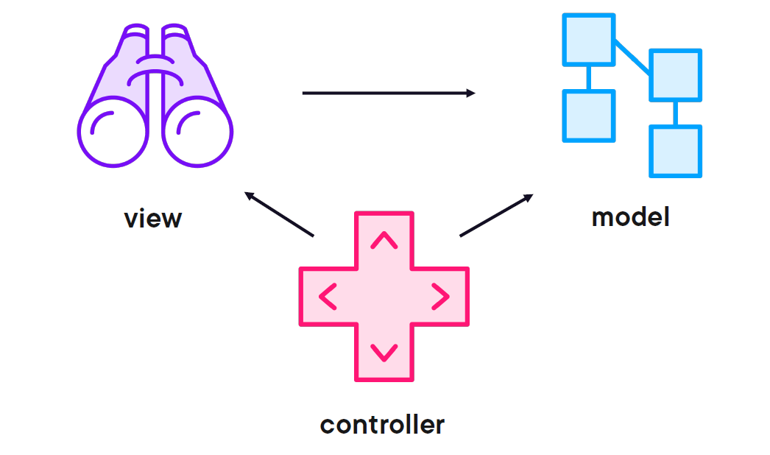
Clarifying the MVC Pattern
Model
Application data and/or business logic & rules View
Representation of model data
Controller
Enables accepting user input and translating that to model data the view
can work with

Slide 12
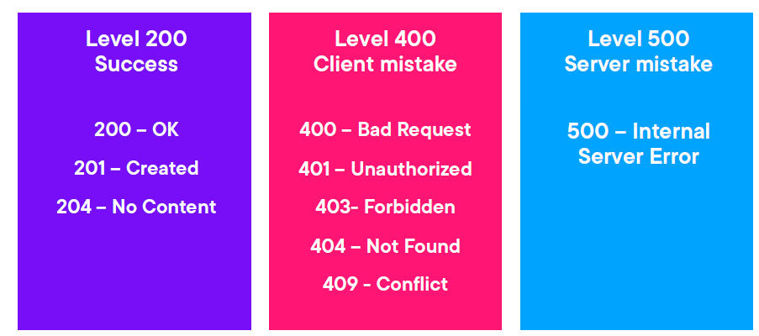
The Importance of Status Codes

